Slide 2
Craft stunning mobile apps with the Xamarin Visual design system
David Ortinau
Principal Program Manager
david.ortinau@microsoft.com
twitter.com/davidortinau twitch.tv/davidortinau

Slide 3


David Ortinau
Principal Program Manager
Mobile Developer Tools
Xamarin
david.ortinau@microsoft.com

Slide 4
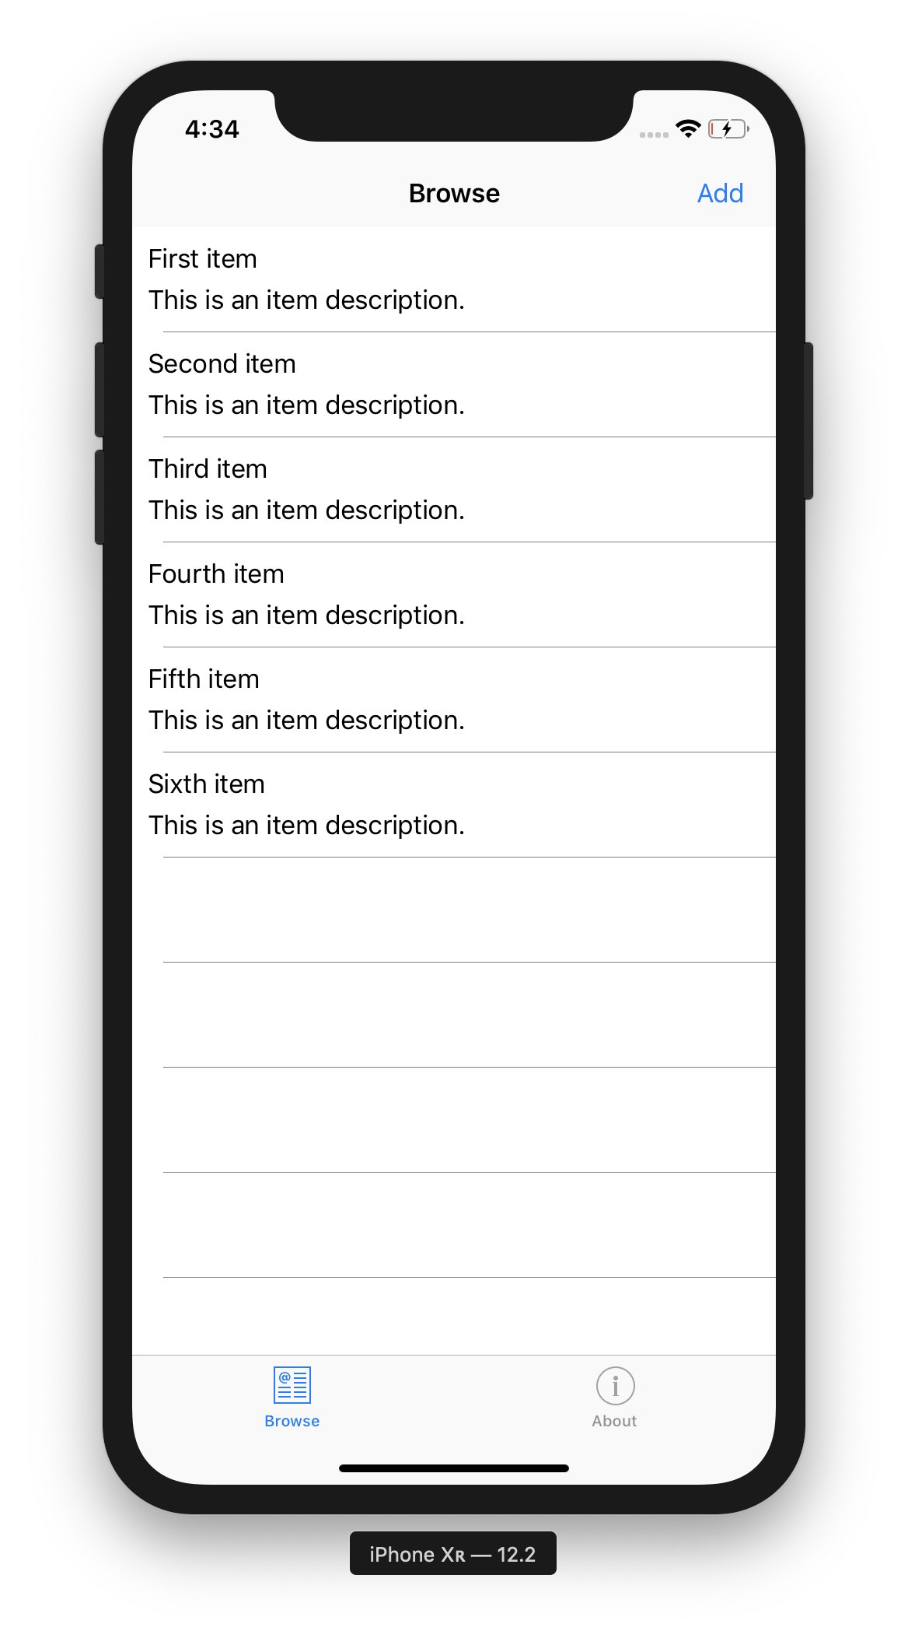
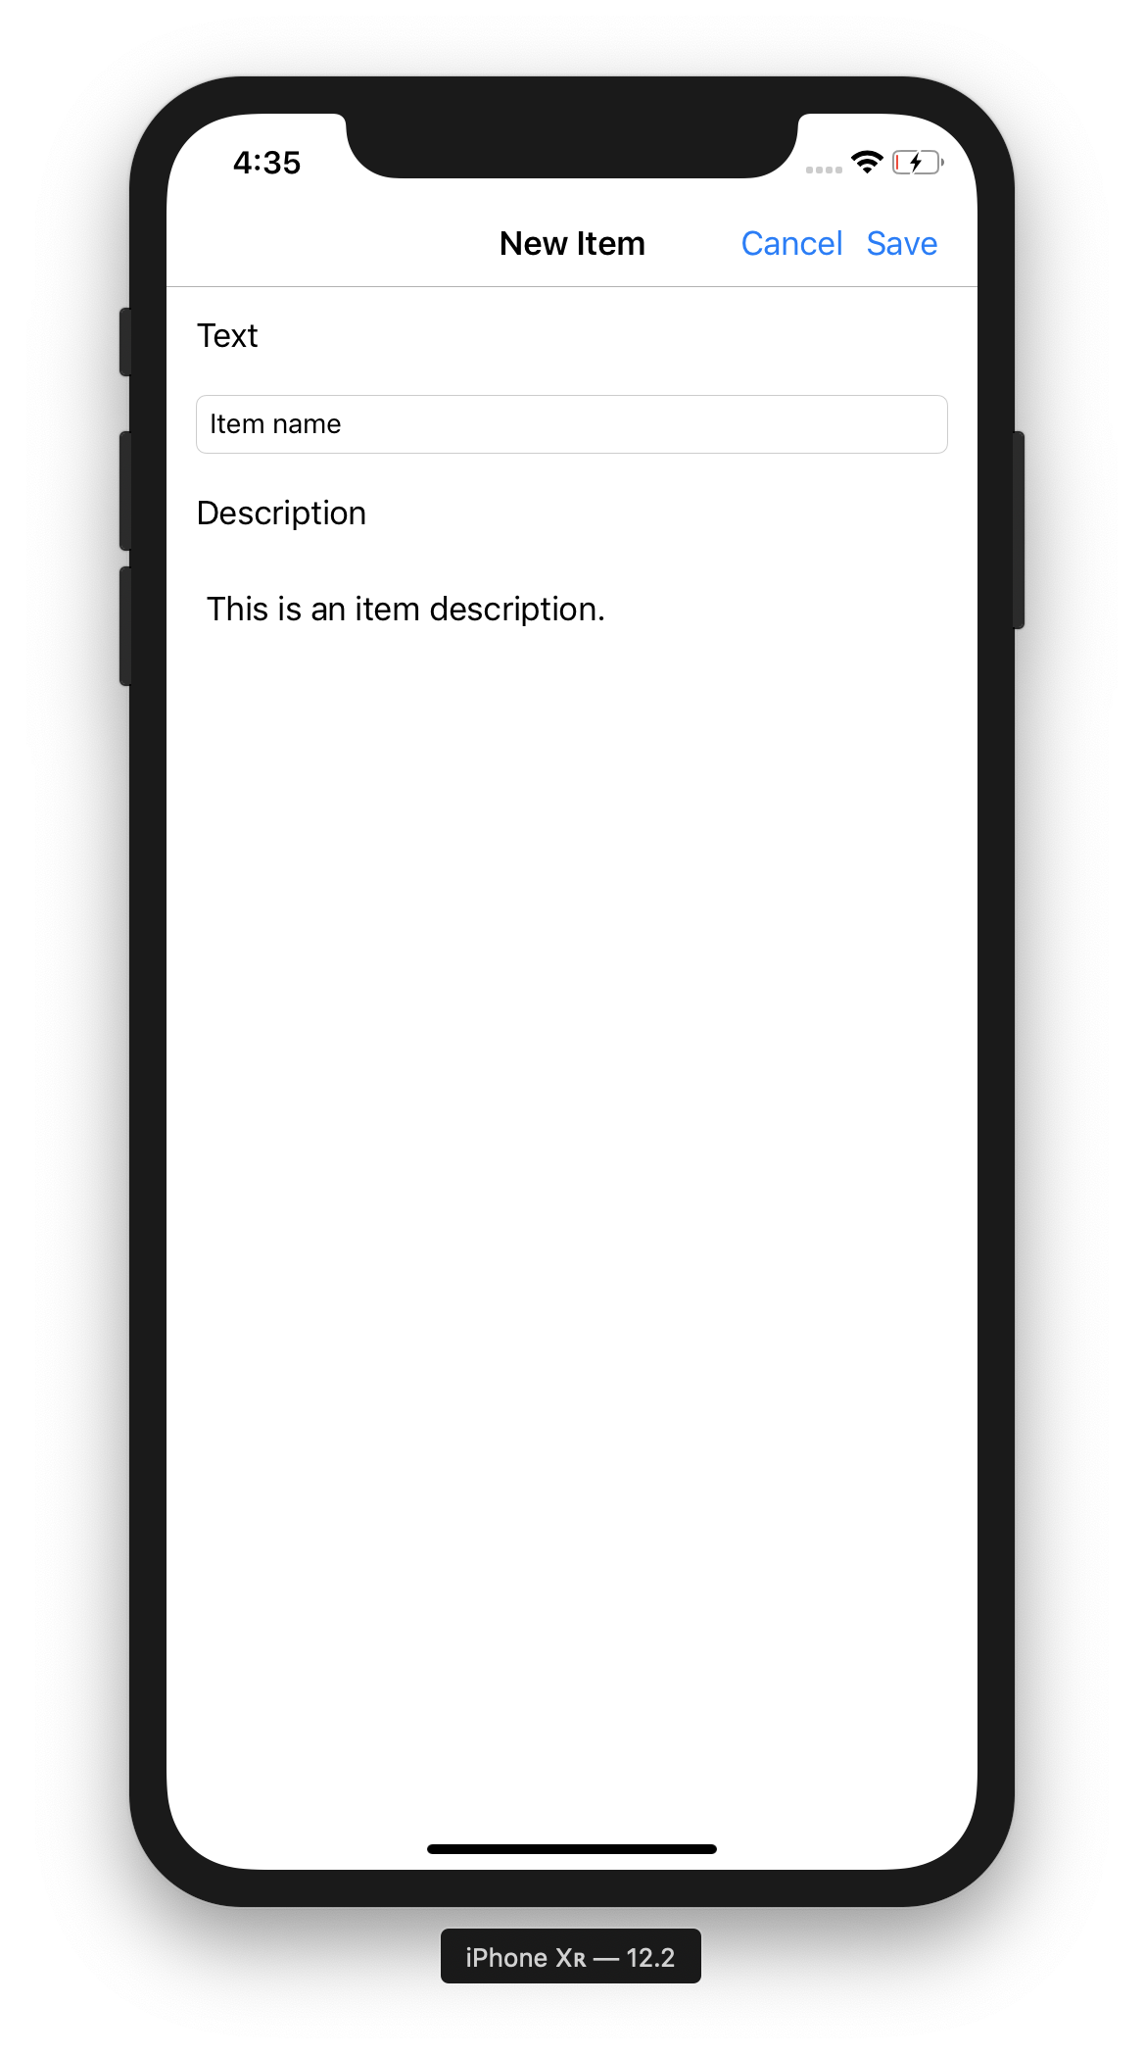
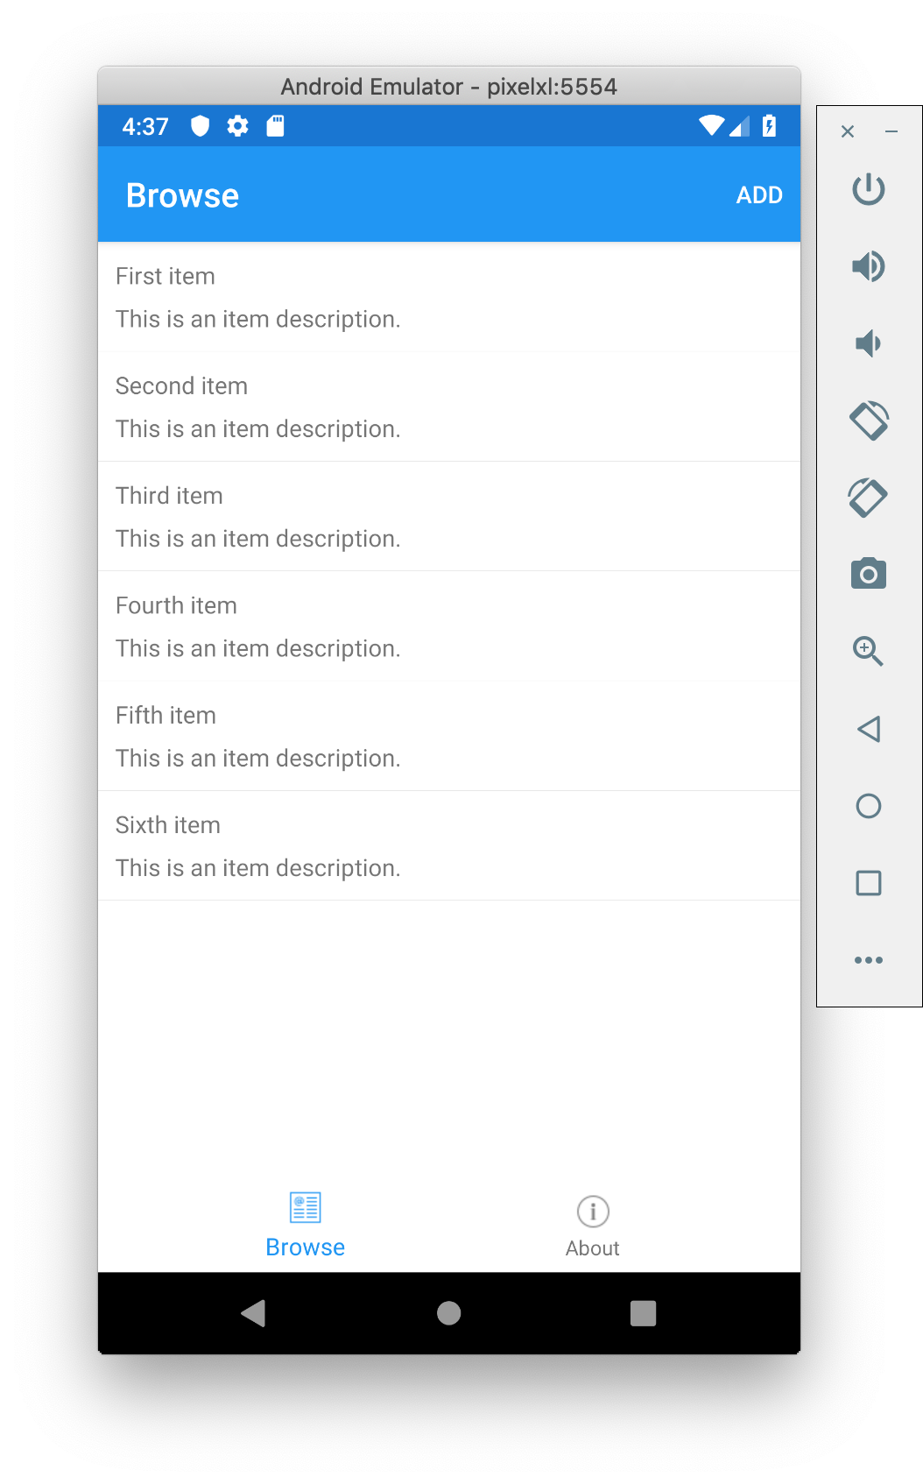
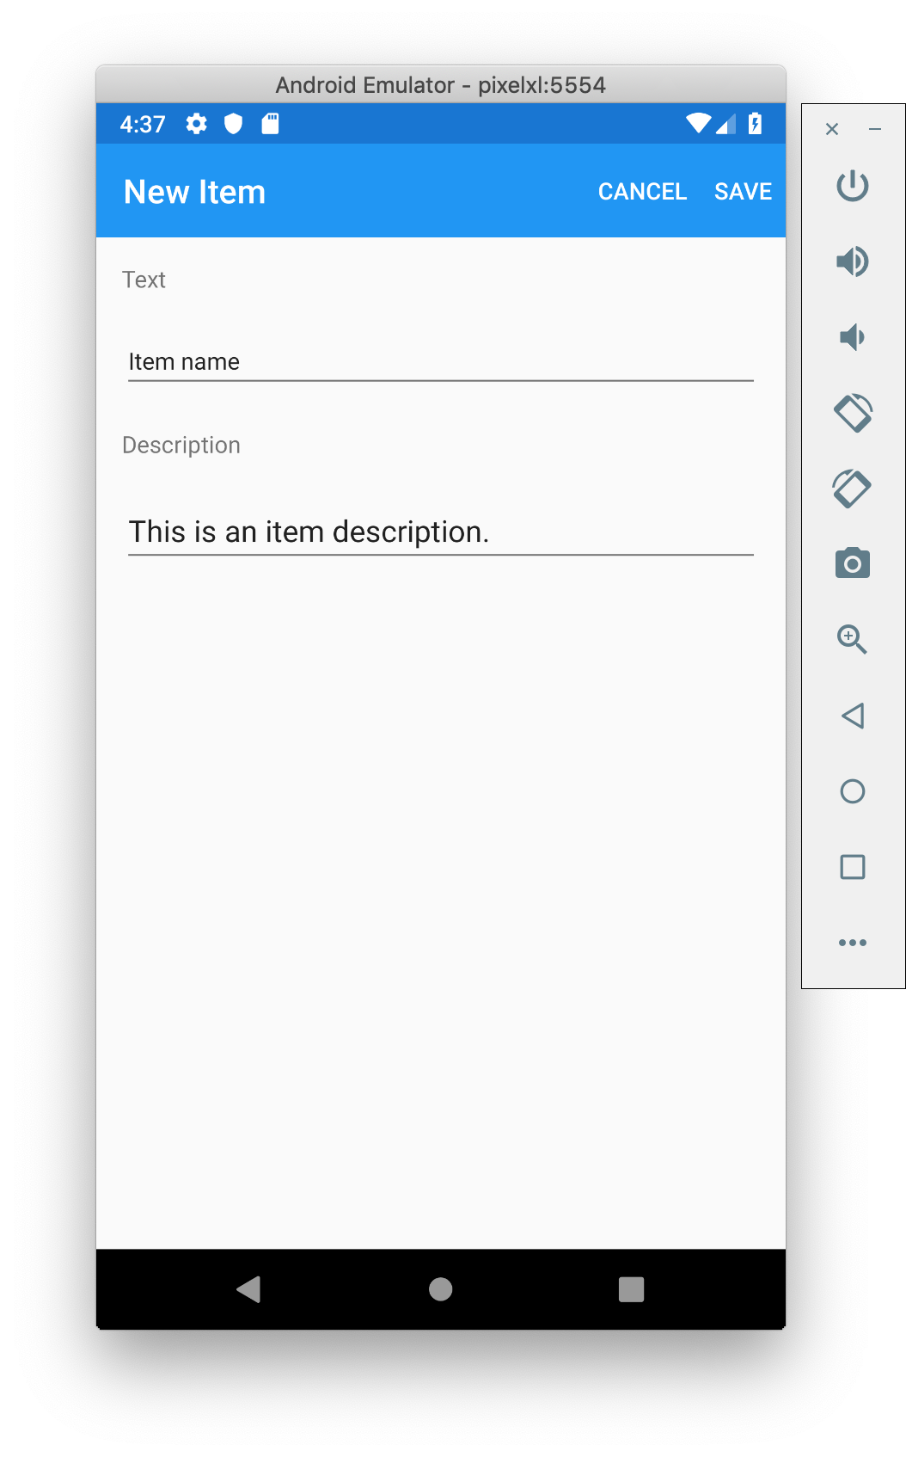
Super Easy to Build Apps Like

Slide 5
But How Do We Easily Build Apps Like

Slide 6
And Like

Slide 7
And Like

Slide 8
And Like

Slide 9
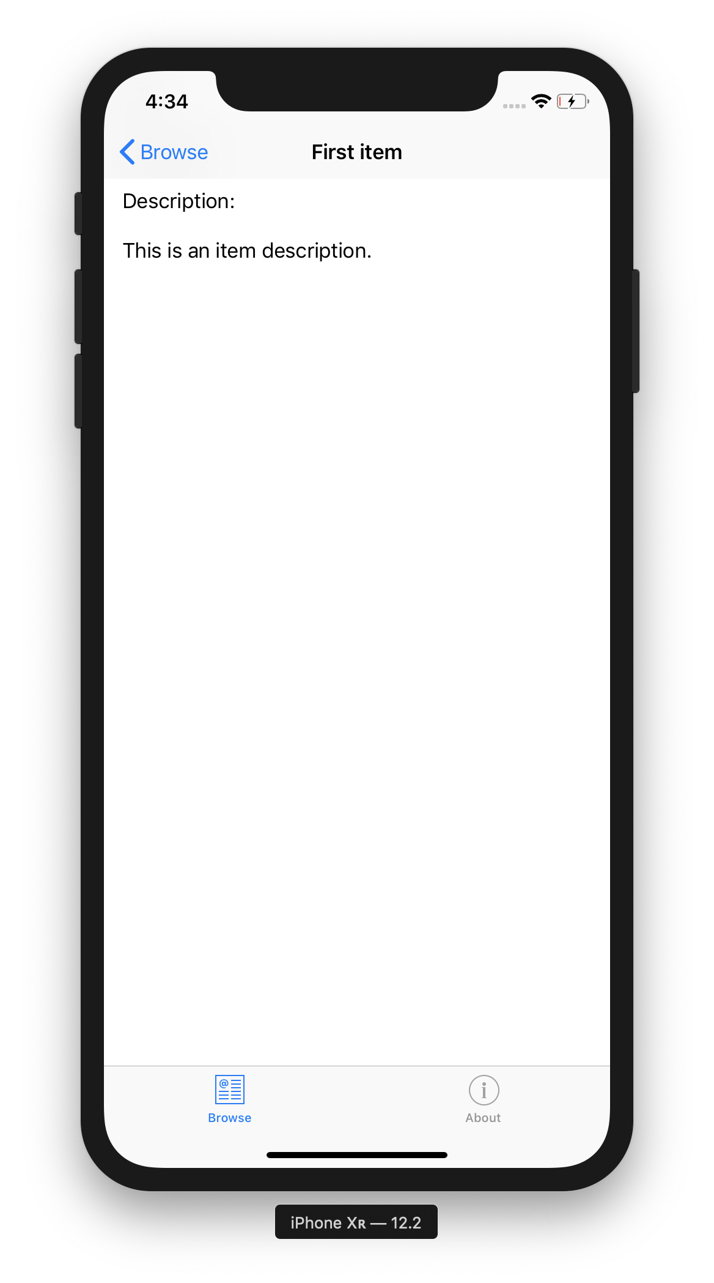
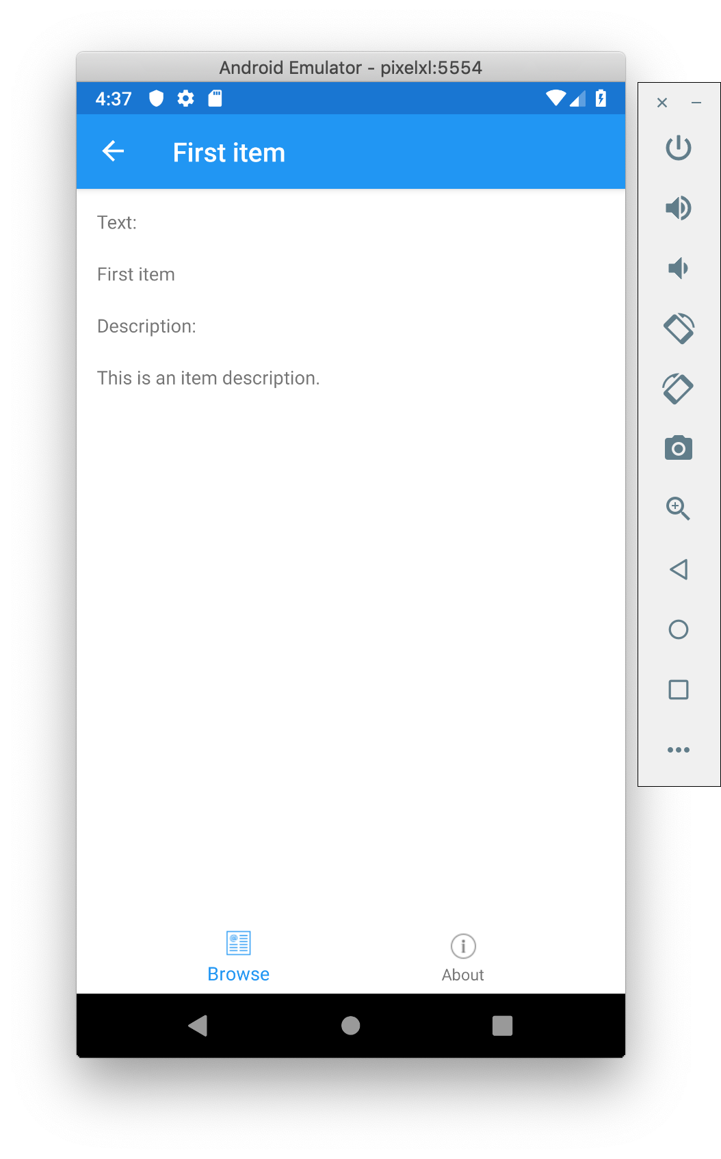
And Like

Slide 10
Visual
A unified way to deliver a curated set of renderers to achieve look and feel across platforms.
Available in:
Xamarin.Forms 3.6 and newer
All Platforms

Slide 11
Material Design
A design system from Google prescribing best practices for creating web and mobile UI.
Promotes usability and an aesthetic
Theme included with Android
Library of controls packaged for iOS

Slide 12
Visual=“Material”

Slide 13
Demo

Slide 14
Getting Started Today!
Install Xamarin.Forms.Visual.Material NuGet into Lib, Android, iOS
Init in MainActivity.cs and AppDelegate.cs
Visual="Material"
https://docs.microsoft.com/en-us/xamarin/xamarin-forms/user-interface/visual/material-visual
ActivityIndicator
Button
CheckBox
Editor
Entry
Frame
Pickers
ProgressBar
Stepper
Slider

Slide 15
Thanks!
David Ortinau
Principal Program Manager
Mobile Developer Tools
Xamarin
david.ortinau@microsoft.com

